Slide 1
Module 5: Starting Asynchronous Processes
SER 423

Slide 2
Declaring an Asynchronous Function

Slide 3
Making an Asynchronous Function
You can make pretty much any function execute asynchronously
  Obviously, you should only do it if it makes sense to do so
We need to use the async keyword to declare our function as asynchronous
By marking the function with await, it means the function will return a promise
A promise is an object that represents the eventual result of an async operation
It is an object with callbacks attached to it, instead of you passing callbacks to the function
This allows for more clear design with the callback function setup
The promise will take both a success and a failure callback using the then method on the object

Slide 4
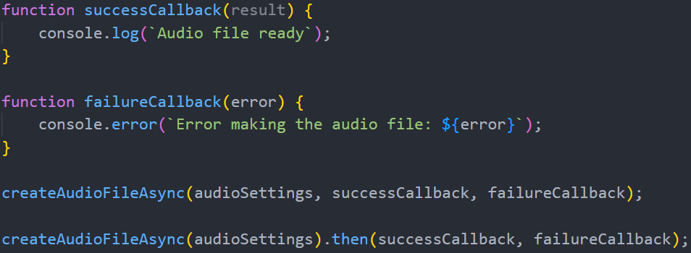
Using Promises

Slide 5
Arrow Functions
Quick aside
These are limited compact alternatives to normal function definitions
These are the same idea as lambdas or anonymous functions that you might already be familiar with
We create a nameless function possibly with parameters and define a function
The returned value is either used or stored right away
We discuss this here because many async functions make use of arrow functions
This includes examples from the book

Slide 6
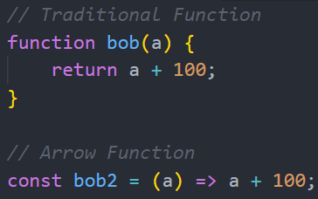
Example Arrow Function

Slide 7
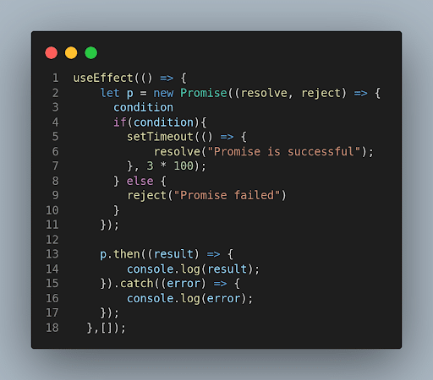
Example Promise

Slide 8
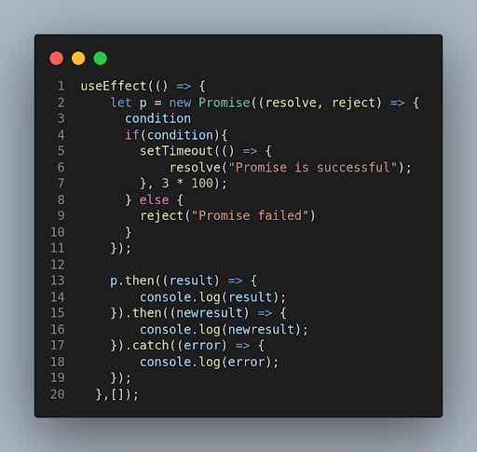
Chaining Promises

Slide 9
Making an Actual Asynchronous Function
Let’s look at the actual function itself
As stated before, you can make most methods into an asynchronous one
Therefore the method is largely written as normal
A key difference is your use of an asynchronous step somewhere in the function
To mark a step as asynchronous, you use the await keyword
This is the keyword that starts an asynchronous action
While the async keyword denotes that your function returns a promise, await makes the function wait for a promise
The function will pause at this step until the async process completes
  Successfully or not
The rest of the function will then continue as normal until the end
Note: Many functions you will want to call await on throw exceptions so be prepared

Slide 10
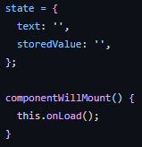
Example Setup

Slide 11
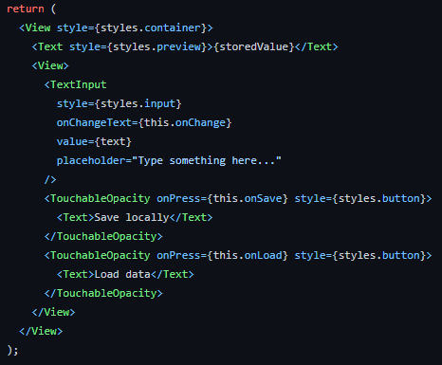
Render Setup

Slide 12
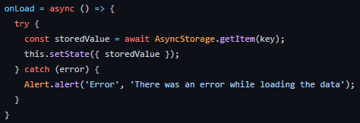
Actual Asynchronous Function

Slide 13
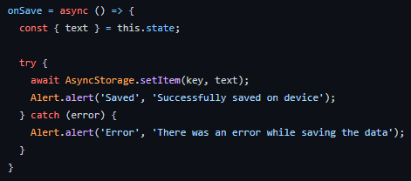
Second Example

Slide 14
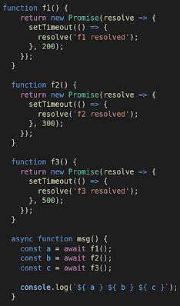
Another Example

Slide 15
End of Starting Asynchronous Actions
That’s all for Module 5!

